Slide 1

Research Examples with LLM Agents
Some inspiration from our research
Sascha Kaltenpoth

Slide 2
AProSys AI-supported assistance and forecasting systems for sustainable use in intelligent distribution network technology
1

Slide 3
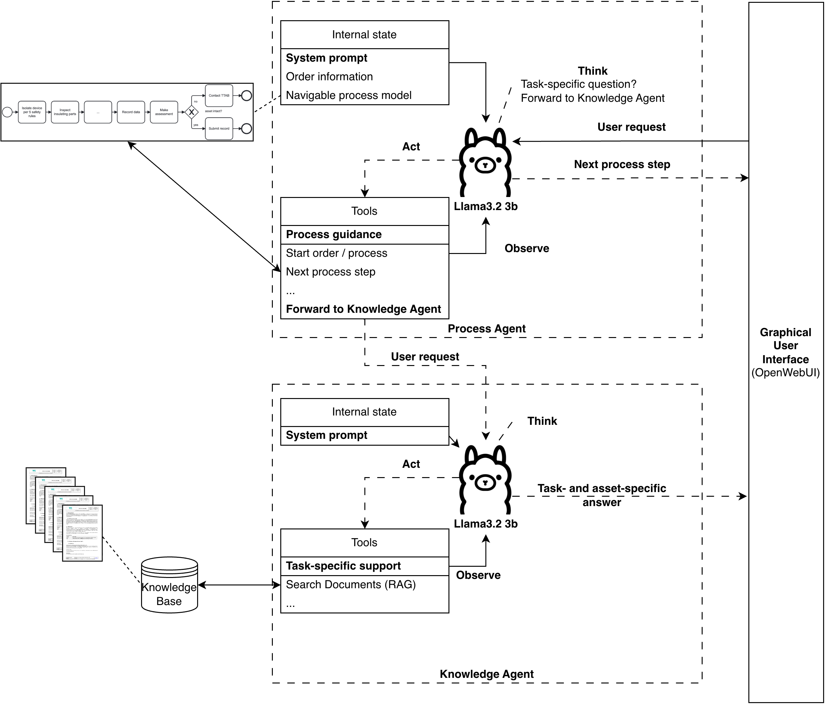
What did we do? (forthcoming, research preview)
We implemented (forthcoming):
A multi-agent system
Based on tool calling
One agent guides through a predefined process
The other answers questions

Slide 4
A Step Towards Cognitive Automation: Integrating LLM Agents with Process Rules
1

Slide 5
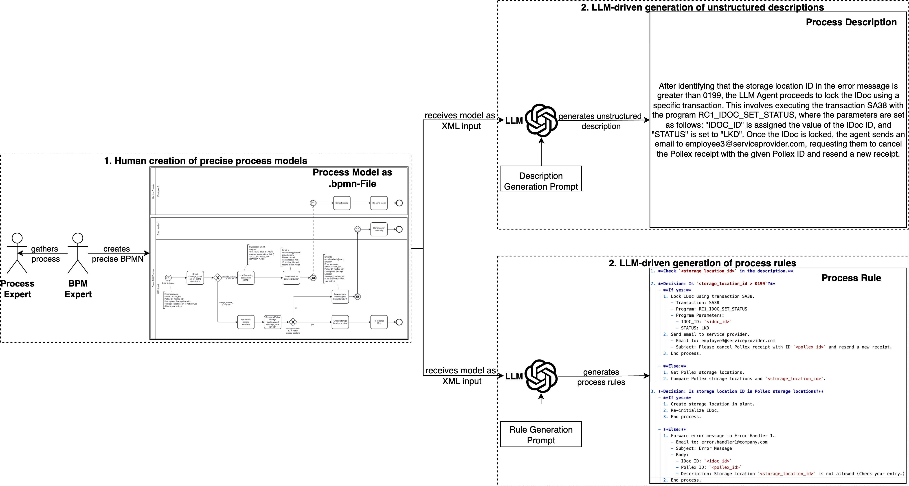
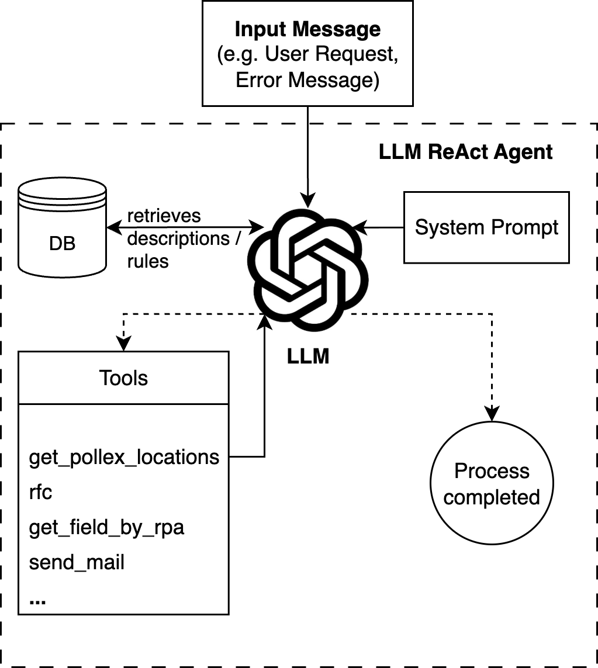
What did we do? (Kaltenpoth et al., 2025)
1. Process rules
We implemented:
A an LLM agent
That automates processes using process rules → structured descriptions of the process that were generated from BPMN files or natural language
Increases automation accuracy of. the LLM agent from 85% to 99%
2. LLM agent

